Slide 1
Vector in C++ STL Md. Alamgir Hossain Senior Lecturer, Dept. of CSE, Prime University Mail: alamgir.cse14.just@gmail.com

Slide 2
Vector
Vectors are the same as dynamic arrays with the ability to resize themselves automatically when an element is inserted or deleted, with their storage being handled automatically by the container.
Vector elements are placed in contiguous storage so that they can be accessed and traversed using iterators.
In vectors, data is inserted at the end.
Inserting at the end takes differential time, as sometimes there may be a need of extending the array.
Removing the last element takes only constant time because no resizing happens.
Inserting and erasing at the beginning or in the middle is linear in time.

Slide 3
Functions associated with Vector
begin() – Returns an iterator pointing to the first element in the vector
end() – Returns an iterator pointing to the theoretical element that follows the last element in the vector
size() – Returns the number of elements in the vector.
max_size() – Returns the maximum number of elements that the vector can hold.
resize(n) – Resizes the container so that it contains ‘n’ elements.
empty() – Returns whether the container is empty.
at(g) – Returns a reference to the element at position ‘g’ in the vector

Slide 4
Functions associated with Vector
front() – Returns a reference to the first element in the vector
back() – Returns a reference to the last element in the vector
push_back() – It push the elements into a vector from the back
pop_back() – It is used to pop or remove elements from a vector from the back.
insert() – It inserts new elements before the element at the specified position
swap() – It is used to swap the contents of one vector with another vector of same type. Sizes may differ.
clear() – It is used to remove all the elements of the vector container

Slide 5
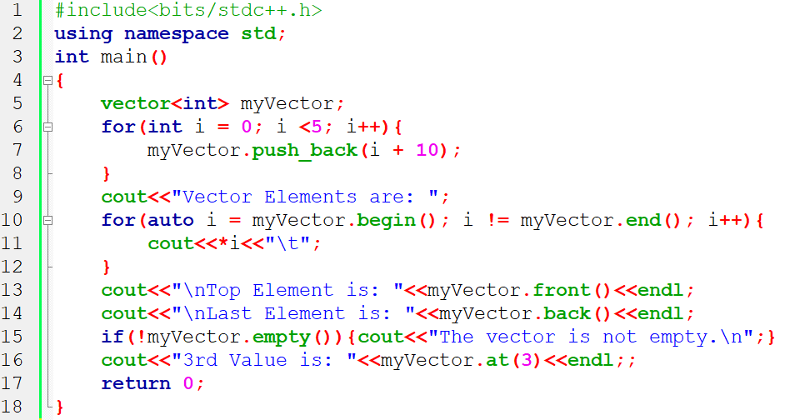
Different Vector Function

Slide 6
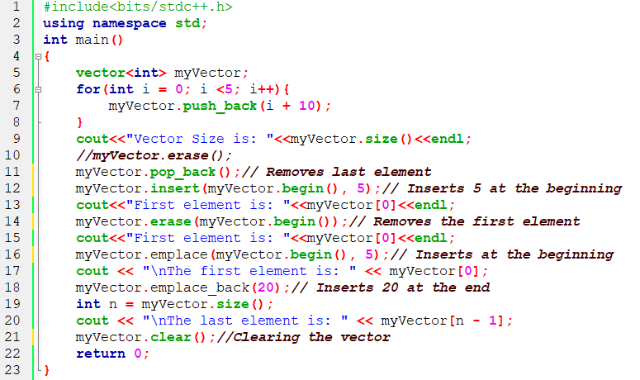
Different Vector Function

Slide 7
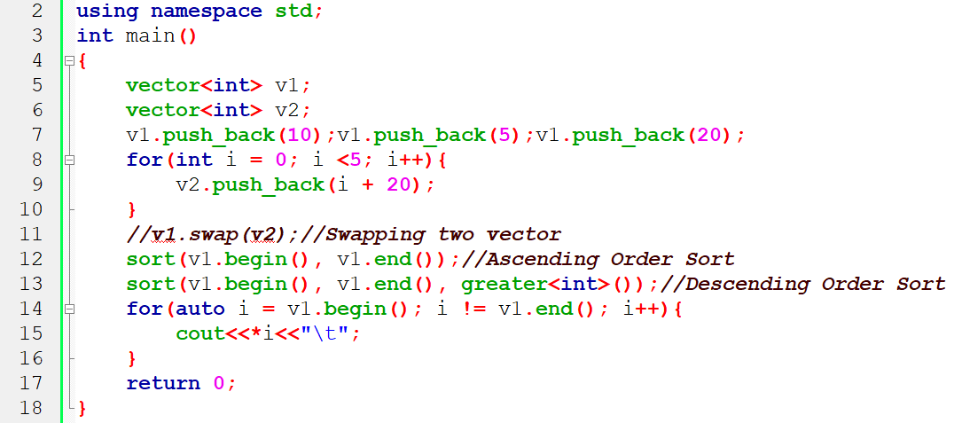
Different Vector Function

Slide 8
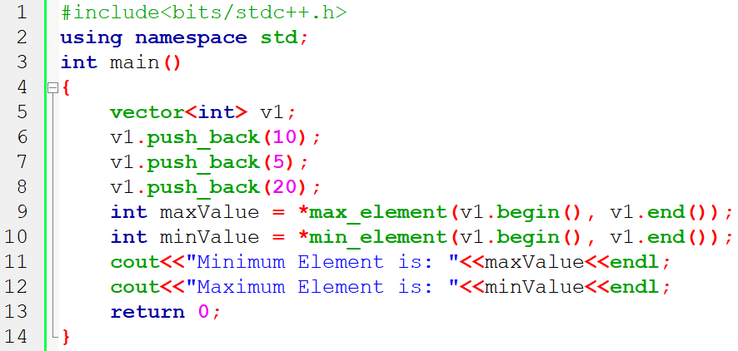
Max Min Element from Vector

Slide 9
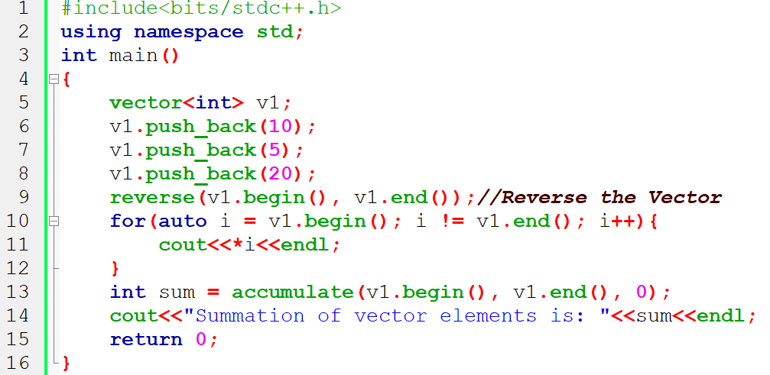
Reverse and Summation of Vector Elements

Slide 10
Functions associated with Vector
Write a C++ program that accepts a even numbers list of five items from the keyboard and stores them in a vector. Extend the program to accomplish the following:
i. To delete a specified item in the list
ii. To add an item at a specified location
iii. To sort the elements in the descending order
iv. To add a smaller item at the end
v. To print the contents of the vector

Slide 11
Thank You

